Slide 1
Subtopic N1.15 – Order any Integers, Decimals and Negatives
LEARNING OUTCOME: To understand how to order decimals.
Objectives:
Keywords:
Decimal
Place Value
Ascending
Descending
To order integers, decimals and negatives using a number line.
To order integers, decimals and negatives without a number line.
To solve problems involving ordering integers, decimals and negatives.
Introduction – Read and annotate:
Ordering a mix of integers, decimals, and negative numbers brings together all the skills we’ve built
so far — understanding place value, comparing numbers, estimating positions on number lines, and
recognising midpoints. By applying these ideas together, we can confidently arrange any set of
numbers from smallest to largest or largest to smallest, whether they’re positive, negative, whole, or
decimal.
Definition
Characteristics
Negative numbers are numbers that represent values that are less than zero. They show things like temperatures below zero, debts and losses.
Negative numbers have a negative sign (-) in front of them.
When comparing negative numbers, the one with the smaller distance from zero is considered greater. For example, -3 is greater than -5 because -3 is closer to 0.
Negative Number
Examples
Non - Examples
-3 -10 -0.5 -⅔ -632.456
5 0 2.5 ⅔ 200 45.67
If the temperature drops below zero, like -10 degrees Celsius, it means it's colder than zero degrees.
Debt: When you owe money, the amount is represented by a negative number.
Positive Numbers: Positive numbers are greater than zero and are not negative.
Zero: Zero is not positive or negative.
Ordering negative numbers
 | Example 1 - I do… | Example 2 – We do… | Example 3 – You do…
Steps | Place the following numbers in ascending order: | Place the following numbers in ascending order: | Place the following numbers in ascending order:
1) Look for the negative furthest from zero. This is the smallest number. 2) Repeat this step for the remaining numbers until all numbers have been ordered. | -3, -7, -2 | -41, -13, -82 | -4, -3, -7
 | -62, -64, -12, -22, - 26 | -17, -45, -19, -44, -27 | -34, -43, -63, -39, -93
-7, -4, -3
-7, -3, -2
-82, -41, -13
-64, -62, -26, -22, -12
-45, -44, -27, -19, -17
-93, -63, -43, -39, -34
‹#›

Slide 2
Ordering positive and negative numbers
 | Example 4- I do… | Example 2 – We do… | Example 6– You do…
Steps | Place the following numbers in ascending order: | Place the following numbers in ascending order: | Place the following numbers in ascending order:
1) Look for the negative furthest from zero. This is the smallest number. 2) Repeat this step for the remaining numbers until all numbers have been ordered. | -9, 9, 0, -1, -7 | -9, 9, 0, -11, -7 | -9, 9, 0, 11, -7
-9, -7, -1, 0, 9
-11, -9, -7, 0, 9
-9, -7, 0, 9, 11
Independent Practice
1. For the following questions, list the numbers in ascending order.
a) -3, 13, 3, -2, 0, 1 | b) -3, -1, 3, -7, 0, 14
c) -13, -1, 3, -7, 10, 14 | d) 13, -11, 3, -72, 104, -4
e) 3, −5, 1, 0, −2, 4 | f) −1, 8, −5, 2, −9, −4, 3
g) −1, −7, −2, 5, −6, 1 | h) 10, −7, −3, 5, −9, −2, −12
-3, -2, 0, 1, 3, 13
-7, -3, -1, 0, 3, 14
-13, -7, -1, 3, 10, 14
-72, -11, -4, 3, 13, 104
-9, -5, -4, -1, 2, 3, 8
-5, -2, 0, 1, 3, 4
-12, -9, -7, -3, -2, 5, 10
-7, -6, -2, -1, 1, 5
2. For the following questions, list the numbers in descending order.
21, −3, 16, −19, −15, 23, −30 | −25, 35, 15, −5, 25, −45, 20
129, 101, −11, −111, 92, −91, 133, −29 | -92, -93, -99, -32, -98
-130, -139, -133, -132, -138 | -180, -189, -183, -182, -138
35, 25, 20, 15, -5, -25, -45
23, 21, 16, -3, -15, -19, -30
133, 129, 101, 92, -11, -29, -91, -111
-32, -92, -93, -98, -99
-138, -180, -182, -183, -189
-130, -132, -133, -138, -139
‹#›

Slide 3
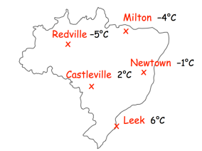

3. Arrange the following temperatures in order, from lowest to highest.
a) -8°C, 12°C, 9°C, -15°C, 11°C, -7°C, 2°C | b) 2°C, −5°C, 4°C, 8°C, −3°C, 1°C, −7°C
4. Arrange the towns in order of temperature, starting with the lowest.
-7°C, -5°C, -3°C, 1°C, 2°C, 4°C, 8°C
-15°C, -8°C, -7°C, 2°C, 9°C, 11°C, 12°C
Redville
Milton
Newtown
Castleville
Leek
5. For the following questions, is the list of numbers ascending, descending or neither?
a) 1, 2, 3, 4, 5 …. | b) 8, 9, 10, 11, 12 …
c) -1, -2, -3, -4, -5 … | d) -8, -9, -10, -11, -12 …
e) 435, 21, 14, 9, 8 … | f) -435, -21, -14, -9, -8 …
g) -8, -9, -14, -21, -435 | h) -8, 9, -14, 21, -435
Ascending
Ascending
Descending
Descending
Descending
Ascending
Descending
Neither
‹#›

Slide 4
Ordering a mixture of decimals, negatives and integers
 | Example 7 - I do… | Example 8 – We do… | Example 9 – You do…
Steps | Place the following numbers in ascending order: | Place the following numbers in ascending order: | Place the following numbers in ascending order:
1) Look for the negative furthest from zero. This is the smallest number. 2) Repeat this step for the remaining numbers until all numbers have been ordered. | -2.3, 2.6, -2.7, 2.9, -2.1, 2.4 | -52.9, -45.6, -60.3, -48.2 | -3.7, 3.2, -3.5, 3.1, -3.3, 3.9
 | -0.4, -0.71, -0.38, -0.402, -0.25 | -0.9, -0.58, -0.702, -0.583, -0.5 | -0.56, -0.813, -0.2, -0.501, -0.123
3.9, 3.2, 3.1, -3.3, -3.5, -3.7
-60.3, -52.9, -48.2, -45.6
2.9, 2.6, 2.4, -2.1, -2.3, -2.7
-0.71, -0.402, -0.4, -0.38, -0.25
-0.813, -0.56, -0.501, -0.2, -0.123
-0.9, -0.702, -0.583, -0.58, -0.5
Independent Practice
6. For the following questions, list the numbers in ascending order.
a) - 0.321, - 0.301, - 0.312, - 0.213, - 0.212 | b) 0.1031, - 0.1021, - 0.2021, - 0.1030, - 0.2020
c) - 0.31, - 0.301, - 0.312, - 0.23, - 0.2 | d) - 0.31, - 0.103, - 0.312, - 0.23, - 0.2
e) - 0.33, - 0.103, - 0.312, - 0.032, - 0.2 | f) - 0.33, - 0.103, - 0.0312, - 0.032, - 0.2
7. For the following questions, list the numbers in descending order.
a) 2.4, -2.1, 2.9, -2.5, 2.7 | b) -3.8, 3.2, -3.5, 3.1, -3.3
c) 4.2, -4.9, 4.5, -4.1, 4.7 | d) -5.6, 5.3, -5.9, 5.1, -5.4
e) 6.3, -6.1, 6.9, -6.5, 6.7 | f) 7.4, 7.2, -7.9, 7.1, -7.6
-0.321, -0.312, -0.301, -0.213, -0.212
-0.2021, -0.2020, -0.1031, -0.1030, -0.1021
-0.312, -0.31, -0.301, -0.23, -0.2
-0.312, -0.31, -0.23, -0.2, -0.103
-0.33, -0.312, -0.2, -0.103, -0.032
-0.33, -0.2, -0.103, -0.032, -0.0312
2.9, 2.7, 2.4, -2.1, -2.5
3.2, 3.1 , -3.3, -3.5, -3.8
4.7, 4.5, 4.2, -4.1, -4.9
5.3, 5.1, -5.4, -5.6, -5.9
6.9, 6.7, 6.3, -6.1, -6.5
7.4, 7.2, -7.1, -7.6, -7.9
‹#›

Slide 5
8. For the following questions, list the numbers in ascending order.
a) -0.876, 1.532, -2.04, 0.3, -1.21, 0.713 -2.04, -1.21, -0.876, 0.3, 0.713, 1.532 | b) -3.1, 1.7, -2.44, 0.9, -0.566, 2.02 -3.1, -2.44, -0.566, 0.9, 1.7, 2.02
c) 0.2, -0.56, 1.004, -2.05, 0.89, -1.2 -2.05, -1.2, -0.56, 0.2, 0.89, 1.004 | d) -2.45, 0.84, -1.009, 0.333, -0.76, 1.234 -2.45, -1.009, -0.76, 0.333, 0.84, 1.234
e) -1.3, 0.567, -0.789, 2.01, -0.456, 1.2 -1.3, -0.789, -0.456, 0.567, 1.2, 2.01 | f) 0.5, -1.234, 2.1, -0.3, 1.009, -0.42 --1.234, -0.42, -0.3, 0.5, 1.009, 2.1
g) -0.84, 1.3, -2.01, 0.56, -1.201, 0.713 -2.01, -1.201, -0.84, 0.56, 0.713, 1.3 | h) -1.8, 0.213, -3.21, 1.4, -0.12, 0.501 -3.21, -1.8, -0.12, 0.213, 0.501, 1.4
i) 0.7, -2.009, 0.123, -1.2, 1.005, -0.888 -2.009, -1.2, -0.888, 0.123, 0.7, 1.005 | j) 0.1, -0.5, 1.006, -2.09, 0.3, -1.234 -2.09, -1.234, -1.006, -0.5, 0.1, 0.3
9. A company is analysing the financial performance of different departments.
They recorded the profit margins for the following departments:
Department A: -3.25%
Department B: 2.5%
Department C: -1.75%
Department D: 4.8%
Department E: -2.1%
Department F: 0.5%
Arrange the departments in ascending order based on their profit margins.
A, E, C, F, B, D

Slide 6
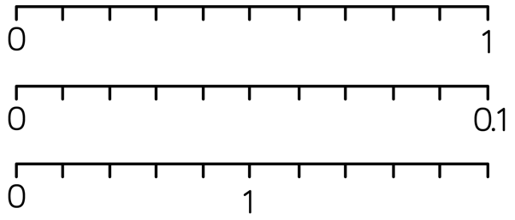
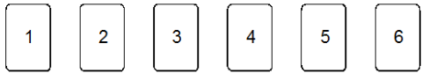
Method Selection
Mixed Fluency
a) Write Three hundred thousand, five hundred and twenty−nine in figures b) Write Seven million, five hundred and two thousand, seven hundred and nineteen in figures c) Write 50,000,012 in words | Write the value of the 4 in each of these numbers: 34601 3.46 43.6 3.64 14.63 f) Now find the median of the five numbers above.
Write these numbers in words: 5.7 5.006 3.02 | Complete each of the following scales:
Unfamiliar Contexts
Hannah is recording the number of letters in each word in an article. These are the first ten lengths. 3 4 5 6 2 4 3 7 3 6 The 11th word has 4 letters. Tick the correct box to describe how the median will be affected. The median will decrease The median will remain the same The median will increase
Here are six number cards. Using all the numbers, what is the smallest number you can make which would round to 1.2?
300,529
4000 (4 thousands)
0.4 (4 tenths)
40 (4 tens)
0.04 (4 hundredths)
7, 502, 719
4 (4 ones)
Fifty thousand and twelve
14.63
Five point seven or Five and seven tenths
0.1 0.2 0.3 0.4 0.5 0.6 0.7 0.8 0.9
Five point zero Castle Ville six or Five and six thousandths
0.01 0.02 0.03 0.04 0.05 0.06 0.07 0.08 0.09
Three point zero two or Three and two hundredths
0.2 0.4 0.6 0.8 1.2 1.4 1.6 1.8 2
✓
1.23456

Slide 7
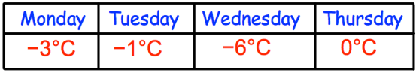
Method Selection
Unfamiliar Contexts (continued)
Shown below are the temperatures recorded over four days. On which day was the lowest temperature recorded? Arrange the temperatures in order, starting with the lowest.
The value of the bold digit in the number 17.405 is 4 tenths. In each of the following, how many times the size of 4 tenths is the value of the underlined digit? a) 47.105 b) 14.705 c) 17.504
What values can each missing digit take? List all possibilities 4?90 = 4000 to the nearest 1000 9?12 = 10,000 to the nearest 1000 34,?90 = 30,000 to the nearest 10,000
Give an example of a number that remains the same when rounded to one, two or three decimal places. | What is the difference between four tenths and forty hundredths? Explain your answer.
Wednesday
-6ºC, -3ºC, -1ºC, 0ºC
100
10
0.01 (accept ÷ 100)
4, 3, 2, 1, 0
5, 6, 7, 8, 9
9, 8, 7, 6, 5, 4, 3, 2, 1, 0
e.g. 5.0004
No difference. They are equivalent.

Slide 8
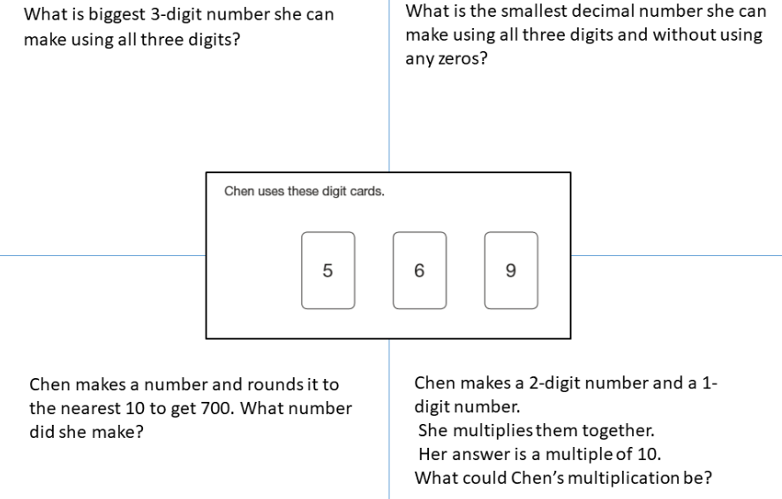
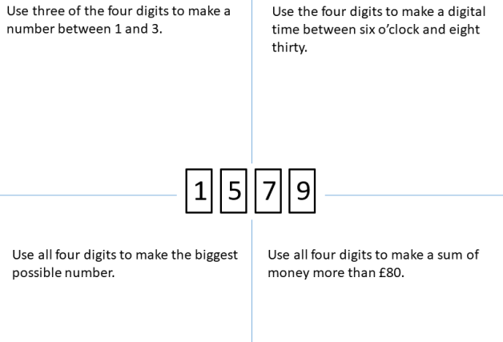
Method Selection
SSDD
SSDD
965
5.69
695
96 x 5
Using each card only once, complete the following inequality:
<
e.g. 1.57
e.g. 9 7 5 1
How many different statements can you make?
12 statements
9751
e.g. £97.51

